Slide 1
Mining Interesting Trivia for Entities from Wikipedia
Supervised By:
Presented By:
Dr. Dhaval Patel,
Assistant Professor,
IIT Roorkee
Abhay Prakash,
En. No. - 10211002,
IIT Roorkee

Slide 2
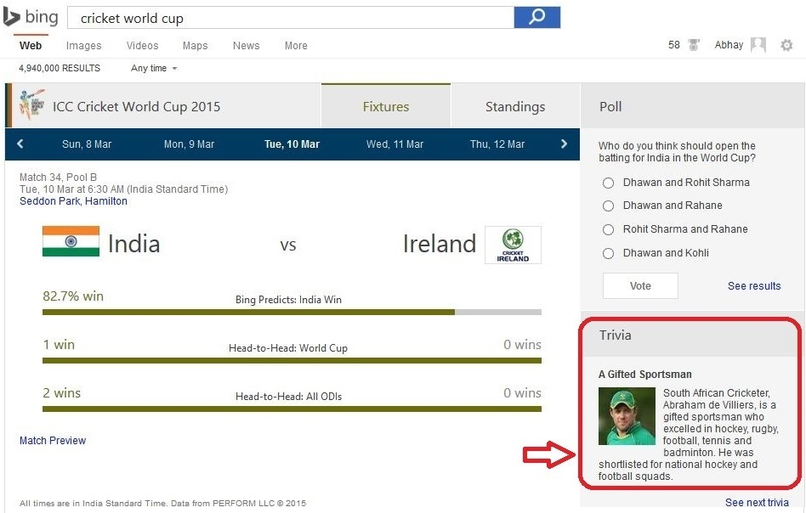
Motivation
User Engagement (Rich Experience)
Facts for quiz games (shows like KBC)
Manual Curation?
Professional Curator
- In 1 day: 50 trivia (spanning 10 entities)
Actual Consumption by Bing during CWC’15

Slide 3
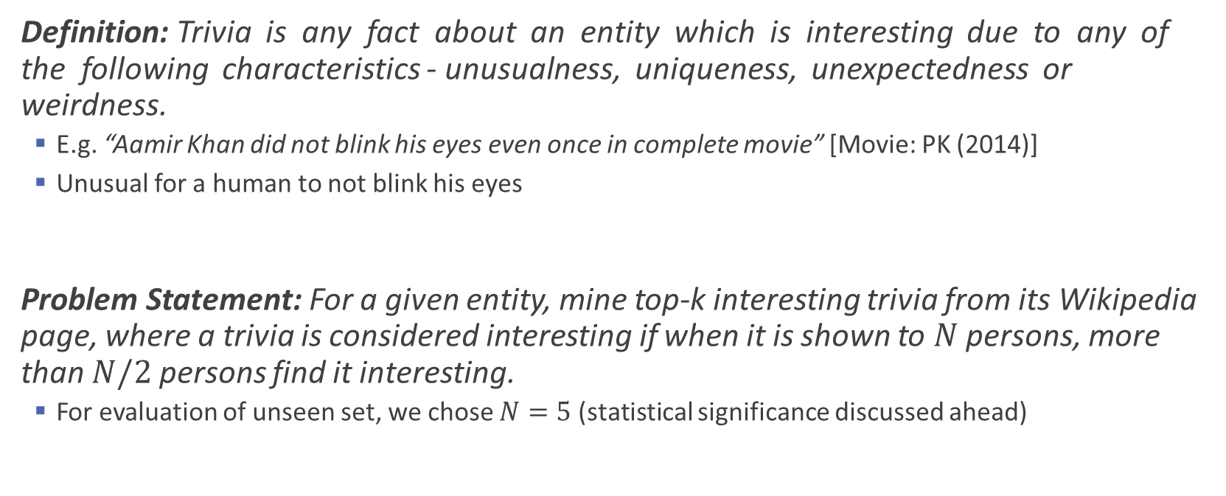
Introduction: Problem Statement
Definition: Trivia is any fact about an entity which is interesting due to any of the following characteristics - unusualness, uniqueness, unexpectedness or weirdness.
E.g. “Aamir Khan did not blink his eyes even once in complete movie” [Movie: PK (2014)]
Unusual for a human to not blink his eyes
Problem Statement: For a given entity, mine top-k interesting trivia from its Wikipedia page, where a trivia is considered interesting if when it is shown to $N$ persons, more than $N/2$ persons find it interesting.
For evaluation of unseen set, we chose $N=5$ (statistical significance discussed ahead)

Slide 4
Position w.r.t Related Works
Automatic generation of trivia questions (2002) [1]
Their Work: Trivia Questions from structured Database.
Difference: WTM retrieves Trivia (facts) from Unstructured Text.
Predicting Interesting Things in Text (2014) [2]
Their Work: Click prediction on anchors(links) with in Wikipedia page.
Difference: WTM is not limited to Links and don’t(can’t) use any click-through data.
Automatic Prediction of Text Aesthetics and Interestingness (2014) [3]
Their Work: One-class algorithm for identifying poetically beautiful sentences.
Difference: Similar Nature, but domain different so engineered features differ a lot.
Man bites dog: looking for interesting inconsistencies in structured news reports (2004) [4]
Their Work: Found unexpected news articles, dependent on ‘structured’ news reports.
Difference: WTM not limited to structured data.

Slide 5



Wikipedia Trivia Miner
Train Phase
Retrieval Phase
Train Dataset
Knowledge Base
Candidates’ Source
Mines Trivia for a Target Entity
Trains a ranker using trivia of target domain
Uses Wikipedia as source of Trivia
Retrieves Top-k interesting trivia from entity’s page
Why Wikipedia?
Reliable for factual correctness
Ample # of interesting trivia (56/100 in expt.)
Two Phases
Model Building (Train Phase)
Retrieval (Test Phase)
Human Voted Trivia Source
Filtering & Grading
Candidate
Selection
Feature Extraction
SVM^{rank}
Feature Extraction
Interestingness Ranker
Wikipedia Trivia Miner (WTM)
Top-K Interesting Trivia from Candidates

Slide 6
System Architecture
Train Dataset
Knowledge Base
Candidates’ Source
Filtering & Grading
Filters reliable samples
Give a grade to each sample
Interestingness Ranker
Extracts features from the samples/candidates
Trains ranker(SVM^{rank})/Ranks candidates
Candidate Selection
Not every sentence is meaningful
Identifies candidates from Wikipedia
Human Voted Trivia Source
Filtering & Grading
Candidate
Selection
Feature Extraction
SVM^{rank}
Feature Extraction
Interestingness Ranker
Wikipedia Trivia Miner (WTM)
Top-K Interesting Trivia from Candidates

Slide 7


Filtering & Grading
TRAIN PHASE
Crawled Trivia from IMDB
Top 5K movies, 99K trivia in total
Filtered on # of votes ≥ 5
$Likeness Ratio \left(L.R\right)= \frac{\# of Interesting Votes}{\# of Total Votes}$
Normal Dist. required on grade
Sample Trivia for movie 'Batman Begins‘ [screenshot taken from IMDB]

Slide 8
Filtering & Grading (Contd..)
TRAIN PHASE
High Support for High LR
For L.R. > 0.6, # of votes >= 100
6163 samples from 846 movies
Graded by Percentile-Cutoff to get 5 grades
[90,100], [75-90), [25-75), [10-25), [0-10)

Slide 9
Feature Engineering
TRAIN PHASE
Unigrams (U): Basic Technique in Text Mining
Linguistic (L): Language Analysis Features
Superlative Words
Contradictory Words
Root Word (Verb)
Subject Word (First noun)
Readability
Entity (E): Understanding/Generalizing the entities present
Present Entities
Linking Entities for Linguistic Features
Focus Entities of sentence

Slide 10
Feature: Unigram Features
TRAIN PHASE
Basic Technique in Text Mining
Each word(unigram) as a feature column, its TF-IDF as feature value
Pre-processing
Stop word removal, Case conversion, Stemming and Punctuation removal
Why this Feature?
Try to identify imp. words which make the trivia interesting
Prominent emerged words - “stunt”, “award”, “improvise.”
e.g. “Tom Cruise did all of his own stunt driving.” [Movie: Jack Reacher (2012)]

Slide 11
Feature: Linguistic Features
TRAIN PHASE
Presence of Superlative Words
Words like “best”, “longest”, “first” etc.
Shows the extremeness (uniqueness)
Identified by Part of Speech(POS) Tags: superlative adjective (JJS) and superlative adverbs (RBS)
E.g. “The longest animated Disney film since Fantasia (1940).” [Movie: Tangled (2010)]
Presence of Contradictory Words
Words like “but”, “although”, “unlike” etc.
Opposing ideas could spark intrigue and interest
E.g. “The studios wanted Matthew McConaughey, but James Cameron insisted on Leonardo DiCaprio.” [Movie: The Shawshank Redemption (1994)]

Slide 12
Feature: Linguistic Features
TRAIN PHASE
Root Word of Sentence
Captures core activity being discussed in the sentence
E.g. “Gravity grossed $274 Mn in North America,” talks about revenue related stuff
Feature column of root_gross
Subject of Sentence (first noun before root verb)
Captures core thing being discussed in the sentence
E.g “The actors snorted crushed B vitamins for scenes involving cocaine.”
Feature column of subj_actor
Readability Score
Complex and lengthy trivia are hardly interesting
FOG Index calculated and binned in three bins

Slide 13
Feature: Entity Features
TRAIN PHASE
Presence of Generic NEs
Presence of NEs: MONEY, ORGANIZATION, PERSON, DATE, TIME and LOCATION
Feature column for each of the six NEs
E.g. “The guns in the film were supplied by Aldo Uberti Inc., a company in Italy.”
ORGANIZATION and LOCATION

Slide 14
Feature: Entity Features
TRAIN PHASE
“According to Victoria Alonso, Rocket Raccoon and Groot were created through a mix of motion-capture and rotomation VFX.”
Present Entities
Presence of related entities (Resolved using DBPedia)
E.g. entity_producer and entity_character in above sample
Entities Linked before Linguistic
“According to entity_producer, …”
Linguistic Feature Subject Word: subj_Victoria → subj_entity_producer
Focus Named Entities of Sentence
Presence of any NE present directly under the root
For above ex. Feature columns of underroot_entity_producer, underroot_entity_character

Slide 15
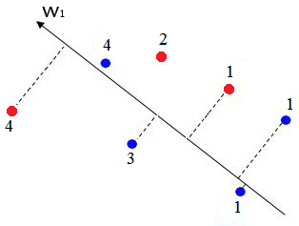
Model Building: Ranker
TRAIN PHASE
Used Rank-SVM
Finds a plane, projection of each sample on which is in given grade order
Pairwise approach: Learns from samples within a movie
MOVIE_ID | FEATURES | GRADE
1 | 1:1 5:2 … | 4
1 | … | 2
1 | … | 1
2 | … | 4
2 | … | 3
2 | … | 1
2 | … | 1
MOVIE_ID | FEATURES
1 | 1:1 5:2 …
1 | …
2 | …
2 | …
2 | …
3 | …
3 | …
SCORE
1.7
2.4
-1.2
2.7
0.13
3.1
-1.3
MODEL
INPUT FOR TRAINING
MODEL BUILT (Hyperplane)
INPUT FOR RANKING
OUTPUT OF RANKING
Image taken and modified from Wikipedia

Slide 16
Model Building: Cross Validate Results
TRAIN PHASE
Feature increment and model building

Slide 17
Model Building: Feature Weights
TRAIN PHASE
Sneak peek inside the model - What the model is learning?
Top Features: Our advanced features are useful
Rank | Feature | Group
1 | subj_scene | Linguistic
2 | subj_entity_cast | Linguistic + Entity
3 | entity_produced_by | Entity
4 | underroot_unlinked_organization | Linguistic + Entity
6 | root_improvise | Linguistic
7 | entity_character | Entity
8 | MONEY | Entity (NER)
14 | stunt | Unigram
16 | superPOS | Linguistic
17 | subj_actor | Linguistic
Entity Linking lead to better generalization
else these would have been subj_wolverine etc.

Slide 18
Retrieval Phase
Train Dataset
Knowledge Base
Candidates’ Source
Human Voted Trivia Source
Retrieval Phase
- Get Trivia from Wikipedia Page
Filtering & Grading
Candidate
Selection
Feature Extraction
SVM^{rank}
Feature Extraction
Interestingness Ranker
Wikipedia Trivia Miner (WTM)
Top-K Interesting Trivia from Candidates

Slide 19
Candidate Selection
RETRIEVAL PHASE
Sentence Extraction
Crawled only the text in paragraph tag <p>…</p>
Sentence detection → each sentence for further processing
Removed sentences with missing context
E.g. “It really reminds me of my childhood.”
Co-ref resolution to find out links to different sentence
Remove if out link not the target entity
e.g. “Hanks revealed that he signed onto the film after an hour and a half of reading the script. He initially ...”
First ‘he’ not an out link, ‘the film’ points to the target entity. Second ‘He’ is an out link
First sentence kept, Second removed

Slide 20
Ground Truth for Model Evaluation
RETRIEVAL PHASE
Candidates selected from Wikipedia, judged (crowd-sourced) by 5 judges
Two scale voting – Boring / Interesting
Majority voting for Class Labeling
Statistically significant?
Got 100 trivia from IMDB also judged by 5 judges only
Mechanism I: Majority voting of IMDB crowd v/s Mechanism II: Crowd-sourced by 5 judges
Agreement between two mechanisms = Substantial (Kappa Value = 0.618)
Kappa | Agreement
< 0 | Less than chance agreement
0.01-0.20 | Slight agreement
0.21-0.40 | Fair agreement
0.41-0.60 | Moderate agreement
0.61-0.80 | Substantial agreement
0.81-0.99 | Almost perfect agreement

Slide 21
Results: Metrics on Unseen: P@10
RETRIEVAL PHASE
Comparative Approaches & Baselines
Random:
- 10 sentences picked randomly from Wikipedia
Random
(Baseline-I)

Slide 22
Results: Metrics on Unseen: P@10
RETRIEVAL PHASE
Comparative Approaches & Baselines
CS + Random:
- Missing context sentences removed by CS - 10 sent. picked randomly
CS then Random
(19.61% Imp.)
B-I

Slide 23
Results: Metrics on Unseen: P@10
RETRIEVAL PHASE
Comparative Approaches & Baselines
CS + supPOS(Worst):
- Ranked by # of sup. words - Deliberately taking boring sent. for same # of sup.
CS + supPOS(Rand):
- Ranked by # of sup. words
- Shuffled for same # of sup. Words
CS + supPOS(Best):
- Ranked by # of sup. words
- Deliberately taking interesting sent. for same # of sup.
supPOS_R
(29.41% Imp.)
supPOS_W
supPOS_B
B-I
(Baseline-II)
supPOS Trivia: Marlon Brando did not memorize most of his lines and read from cue cards during most of the film.

Slide 24
Results: Metrics on Unseen: P@10
RETRIEVAL PHASE
Comparative Approaches & Baselines
CS + WTM(U):
- ML Ranking
- With only basic Unigram(U) features
WTM (U)
B-II
B-I

Slide 25
Results: Metrics on Unseen: P@10
RETRIEVAL PHASE
Comparative Approaches & Baselines
CS + WTM(U): ML Ranking with only (U) features
CS + WTM(U+L+E):
- ML Ranking
- With advanced (U+L+E) features
B-II
WTM (U+L+E)
B-I
78.43% imp. (B-I) 33.82% imp. (B-II)

Slide 26
Results: Metrics on Unseen: Recall@K
RETRIEVAL PHASE
supPOS limited to one kind of trivia
WTM captures varied types
Performance Comparison
superPOS better till rank 3
Soon after rank 3, WTM beats superPOS

Slide 27
Results: Qualitative Discussion
RETRIEVAL PHASE
Result | Movie | Trivia | Description
WTM Wins (Sup. POS Misses) | Interstellar (2014) | Paramount is providing a virtual reality walkthrough of the Endurance spacecraft using Oculus Rift technology. | Due to Organization being subject, and (U) features (technology, reality, virtual)
 | Gravity (2013) | When the script was finalized, Cuarón assumed it would take about a year to complete the film, but it took four and a half years. | Due to Entity.Director, Subject (the script), Root word (assume) and (U) features (film, years)
WTM’s Bad | Elf (2003) | Stop motion animation was also used. | Candidate Selection failed
 | Rio 2 (2014) | Rio 2 received mixed reviews from critics. | Root verb "receive" has high weightage in model

Slide 28
Results: Qualitative Discussion (Contd…)
RETRIEVAL PHASE
Result | Movie | Trivia | Description
Sup. POS Wins (WTM misses) | The Incredibles (2004) | Humans are widely considered to be the most difficult thing to execute in animation. | Presence of ‘most’, absence of any Entity, vague Root word (consider)
Sup. POS's Bad | Lone Survivor (2013) | Most critics praised Berg's direction, as well as the acting, story, visuals and battle sequences. | Here 'most' is not to show degree but instead to show genericity.

Slide 29
Dissertation Contribution
Identified, Defined and Provided a new research problem
not just only providing solutions to existing problem
Proposed a system “Wikipedia Trivia Miner (WTM)”
To mine top-k interesting trivia for any given entity based on their interestingness
Engineered features that capture ‘about-ness’ of sentence
Generalizes which one are interesting
Shown how publicly available IMDB data can be leveraged for model learning
Cost effective, as eliminates the need of crowd annotation
Proposed a mechanism to prepare ground truth for test-set
Cost-effective but statistically significant

Slide 30
Publication Submitted
[1] Abhay Prakash, Manoj Chinnakotla, Dhaval Patel, Puneet Garg (2015): “Did you know?: Mining Interesting Trivia for Entities from Wikipedia”. Submitted in International Joint Conference on Artificial Intelligence (IJCAI).
IJCAI ranking: A* (Ranking from http://lipn.univ-paris13.fr/~bennani/CSRank.html)

Slide 31
Further Work
Replicate the work on Celebrities domain
Verify that WTM approach is actually domain independent
Feature Engineering to capture deviation from expectation
Expectation based on topics in that domain, compare topic of candidate
Fact Popularity
Lesser known trivia could be more interesting to majority people

Slide 32
Key References
[1] Matthew Merzbacher, "Automatic generation of trivia questions," Foundations of Intelligent Systems, Lecture Notes in Computer Science, vol. 2366, pp. 123-130, 2002
[2] Michael Gamon, Arjun Mukherjee, and Patrick Pantel, "Predicting interesting things in text,“ in COLING, 2014.
[3] Debasis Ganguly, Johannes Leveling, and Gareth Jones, "Automatic prediction of text aesthetics and interestingness," in COLING, 2014.
[4] Emma Byrne and Anthony Hunter, "Man bites dog: looking for interesting inconsistencies in structured news reports," Data and Knowledge Engineering, vol. 48, no. 3, pp. 265-295, 2004.

Slide 33
